Slide 1
Alaska Tideland Leases and Permits
Croix Fylpaa 04/01/2020
Environmental Management and permitting enve 644

Slide 2
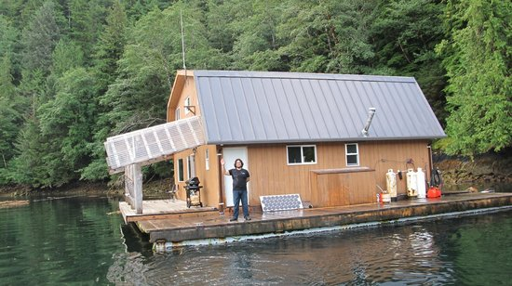
AK Tidelands
Permits and Leases Administered by AK DNR Division of Mining, Land and Water
Statues are under AS 38.05.821 and AS38.05.855 Public Land - Land Act and Tidelands
Shore Fish set netting Leases
Tideland Leases – Competitive, or Non-competitive for upland owners
  Mariculture Shellfish or Kelp bed Farms
Tideland Permits
Mooring Buoys
Log Transfer Facilities
Floathomes, Float Camps, Floating Lodges, Floating Recreational Facilities

Slide 3
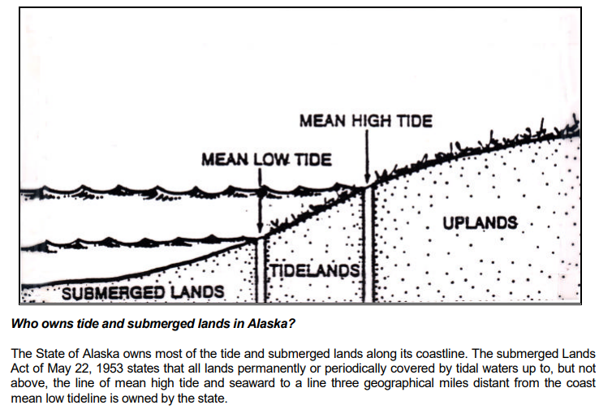

Slide 4
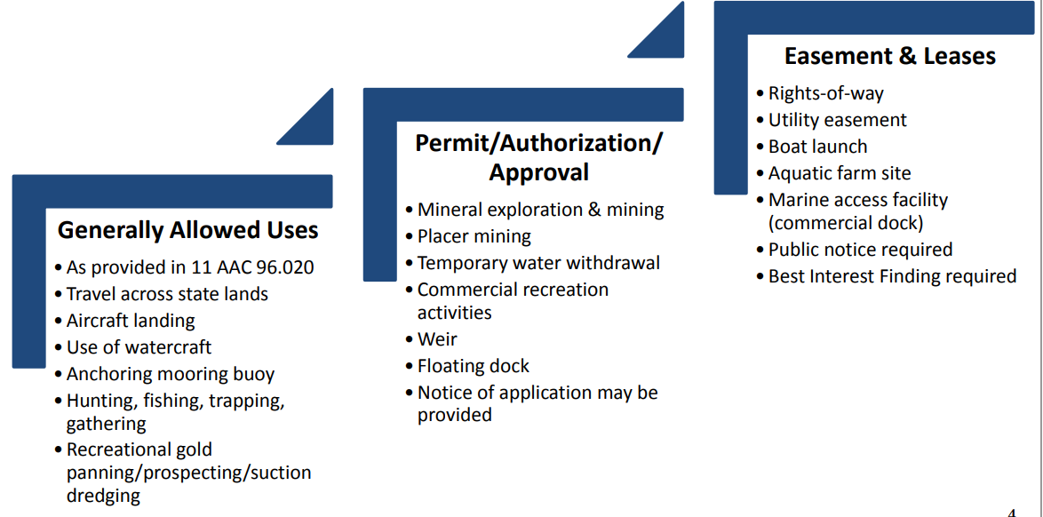
Allowed, Permit, or Lease Required?

Slide 5
Generally Allowed Uses
As provided in 11 AAC 96.020, the following uses and activities are generally allowed on state land managed by the Division of Mining, Land and Water - do not require a permit from the Division of Mining, Land and Water.
Travel across state lands
Aircraft Landing
Watercraft Landing
Anchoring mooring buoy
Hunting, Fishing, Trapping, and Gathering
Recreational Gold panning/ prospecting and suction dredging
Temporary camping
These uses generally occur without damaging the land, including shoreland, tideland, and submerged land.

Slide 6
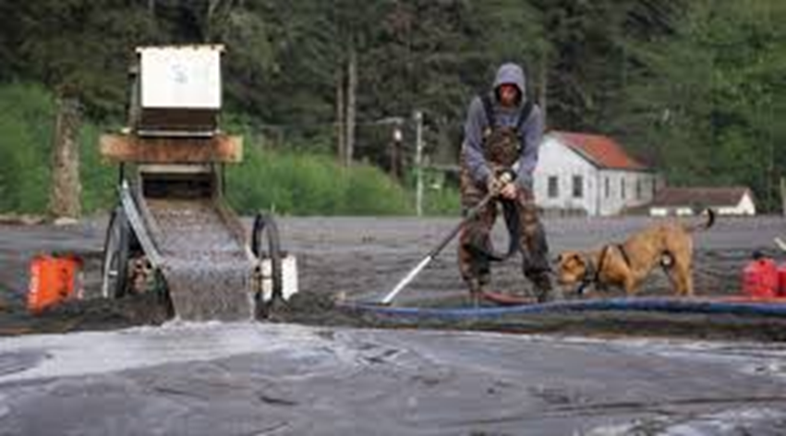
Generally allowed Mining Uses
Recreational gold panning; hard-rock mineral prospecting or mining using light portable field equipment, such as a hand-operated pick, shovel, pan, earth auger, or a backpack power drill or auger;
Suction dredging using a suction dredge with a nozzle intake of six inches or less, powered by an engine of 18 horsepower or less, and pumping no more than 30,000 gallons of water per day. An authorization is required from ADF&G-Habitat prior to dredging in fish bearing streams.

Slide 7
Fine print for generally allowed uses
Before beginning an activity on state land, the user should check to be sure it is generally allowed in that particular area.
-- Note that this list does not apply to state parks, nor to land owned or managed by other state agencies such as the University of Alaska, Alaska Mental Health Trust, Department of Transportation and Public Facilities, or the Alaska Railroad.
You may need other state, federal or borough permits for these uses or activities. Permits can be required from the Army Corps of Engineers, Department of Environmental Conservation, the Environmental Protection Agency, Alaska Department of Fish and Game Habitat Division (ADF&GHabitat).

Slide 8
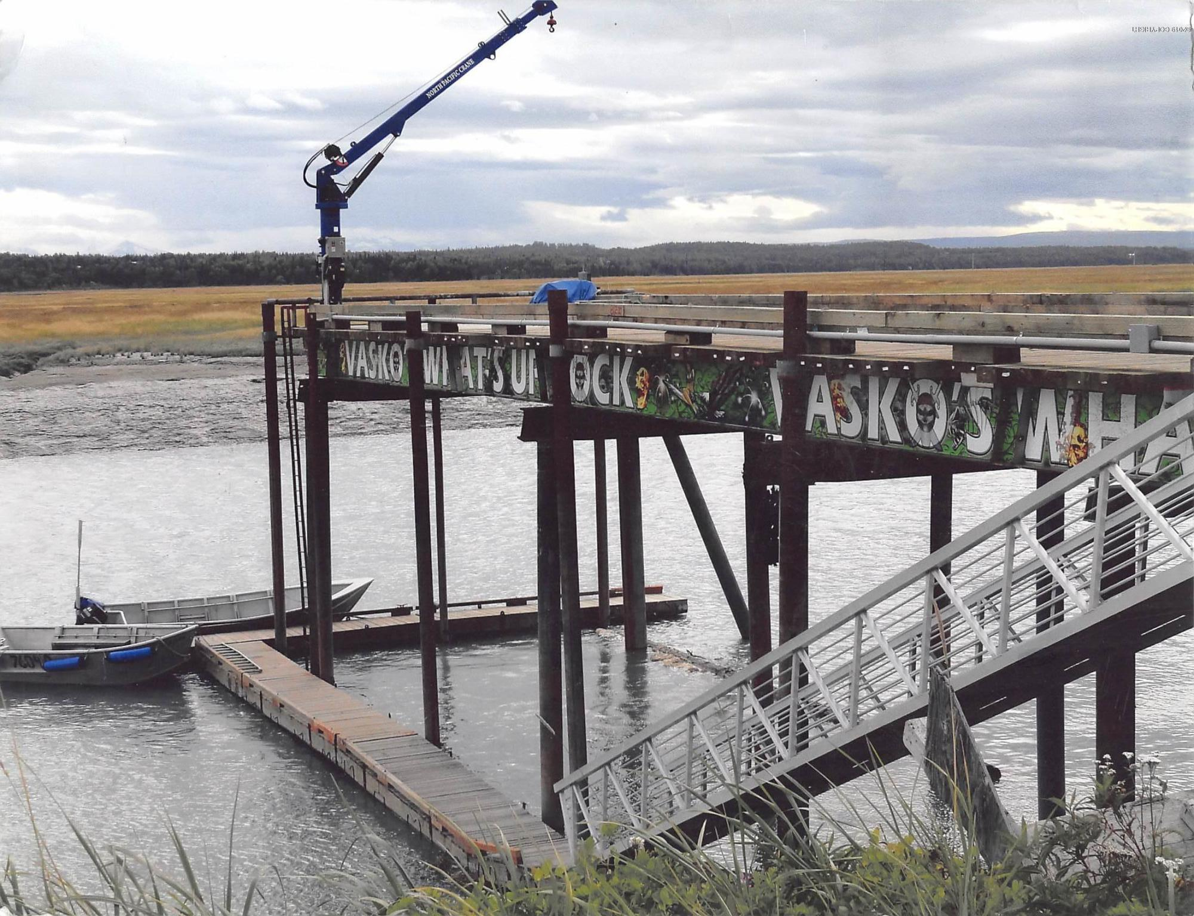
Permits
Semi – permanent placements or projects
Mineral Exploration and mining
Placer mining
Temporary water withdrawal
Commercial Recreation activities
Weir
Floating dock
May require public notice of application
Generally follow Upland Permitting Statutes with AK DNR Mining Lands and Water :http://dnr.alaska.gov/mlw/permit_lease/
With Additional Surveying of Tidal Zone and planned Construction.

Slide 9
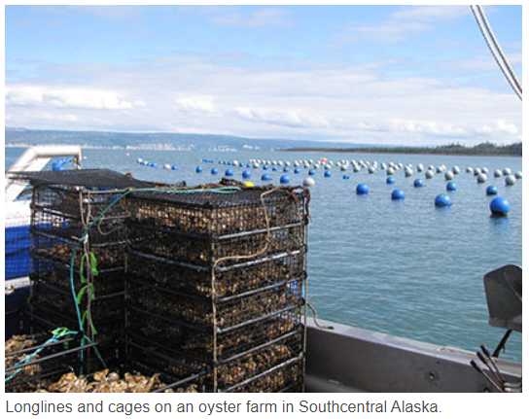
Leases and Easements
Rights-of-Way
Utility easements
Boat launch
Aquatic Farming Sites
Marine access facilities, ie. Commercial docks
Public notice of Application is required
Best Interest Finding is required

Slide 10
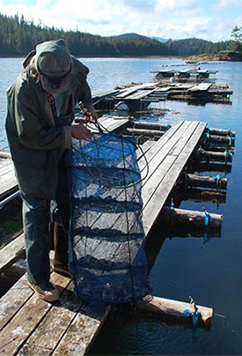
Aquatic farm application
Application located on DNR Aquatic Farming website : http://dnr.alaska.gov/mlw/aquatic/
Cynthia Pring-Ham, Aquatic Farming Coordinator
(907) 465-6150
cynthia.pring-ham@alaska.gov
Application period is January 1 – April 31 Permitting Process takes approximately 12 Months
Application fee: $100, Survey fee: $2,000 intertidal survey, 5,000 for subtidal survey
Requires Detailed Project description, General Location map on USGS topo map,
Detailed Map on NOAA Nautical Chart, Site Plan Map, Cross-Section Diagram of all facilities, equipment, gear and anchoring systems,
Ownership deed for any upland facility use not on state lands

Slide 11
Application Process
This schedule will be used as basis for annual rent in leasing tide, submerged, and shore land suitable for aquatic farmsites under AS 38.05.083. The annual lease fees for aquatic farmsites are:
Tide and/or submerged land for an aquatic farm site: - $450 per acre for the first acre of portion thereof, and - $125 per acre for each additional acre or portion thereof;
Associated housing facilities for the aquatic farm site: • $875 for the first acre of tide or submerged land or portion thereof, and • $125 per acre for each additional acre or portion thereof;

Slide 12
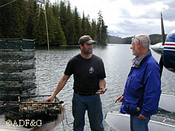
The following is a general time-table for processing a Tideland lease:
1. Application received, serialized and photo-copied.
2. In-house and agency review ................................................ *30 days
3. Preliminary decision................................................................30 days
4. .945 notice letters (A.S. 38.05.945(c) ...................................30 days
5. .945 public notice (newspaper ad)(AS 38.05.945(b))........ 30 days
6. Survey and appraisal (11AAC 58.400 - .410)..................... 60 days
7. Final decision............................................................................ 10 days
8. .945 notice letters (if competitive offerings).......................30 days
9. .945 public notice (if competitive)........................................ 30 days
10. Lease offering........................................................................... 10 days

Slide 13
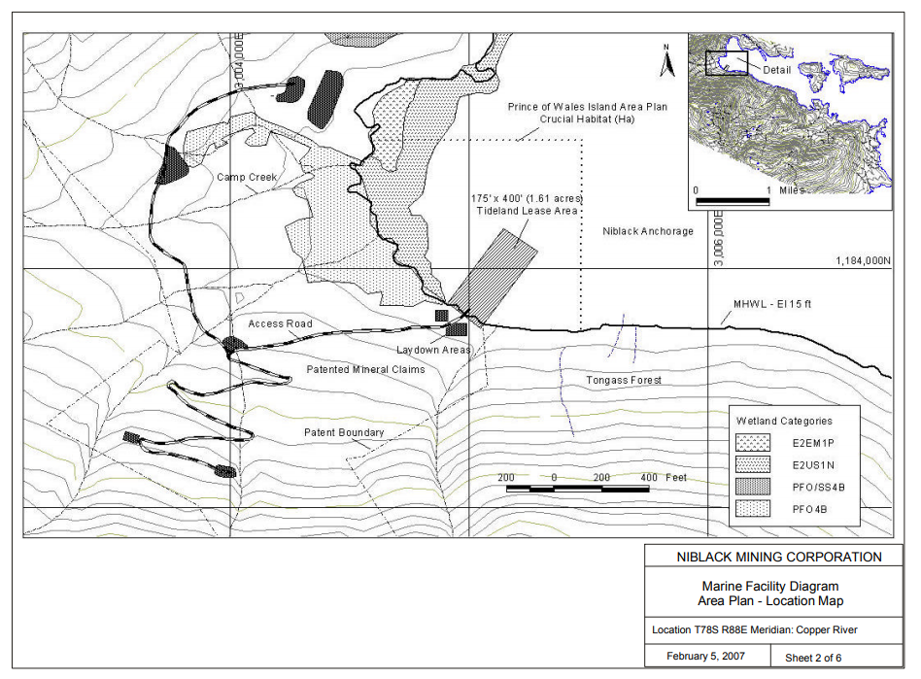
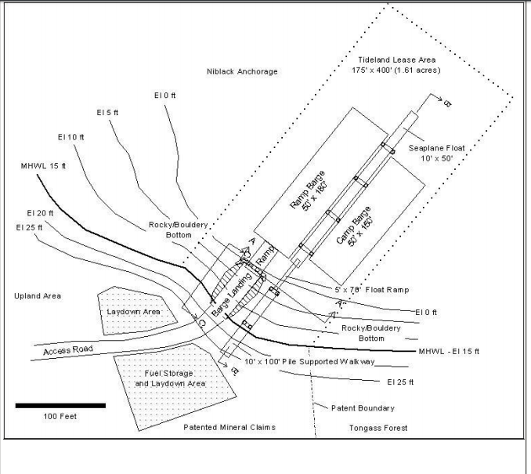

Slide 14
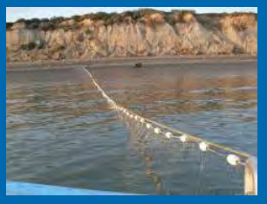
Shore Fishery Lease
A Shore Fish Lease is a limited exclusive interest or first priority right to use a leased site, and to exclude other fishermen only when the lessee is physically present and fishing.
Shore Fishery Leases are governed by an individual set of Statutes and Regulations as provided under AS 38.05.082 (Statute) and 11 AAC 64 (Regulation)
Stake the site(s) between May 2 and October 15.
File an application within 30 days of staking the site and between June 1 and October 15. •
Applications are sent out for Agency and Public Notice. •
Have a Shore Fishery Diagram prepared by a licensed surveyor. •
Lease Issuance of up to 10 years.
How Much Does It Cost for a Shore Fish Lease? $300 $1000 +/- Application Fee Diagram (cost varies by surveyor) Diagram Review Fee Lease Annual Rent $450 $300 per year

Slide 15
Accreted Lands
What is Accretion / Reliction? Sometimes a land survey involving coastal or shoreline areas will show that there is now more upland area than what was shown on the original survey. The extra land may be the result of natural processes.
Accretion is the gradual and imperceptible addition of land to a parcel by the natural deposition of water borne sediments. It is the slow increase in one’s land occurring grain by grain.
Reliction, which is the uncovering of submerged land by the recession of water, is legally treated as accretion even though the process is different. In 1982, the Alaska Supreme Court ruled in Honsinger v. State of Alaska that glacio-isostatic uplift is a form of reliction and therefore subject to common-law doctrine of accretion. “Benefit inures to shoreline owner.”

Slide 16
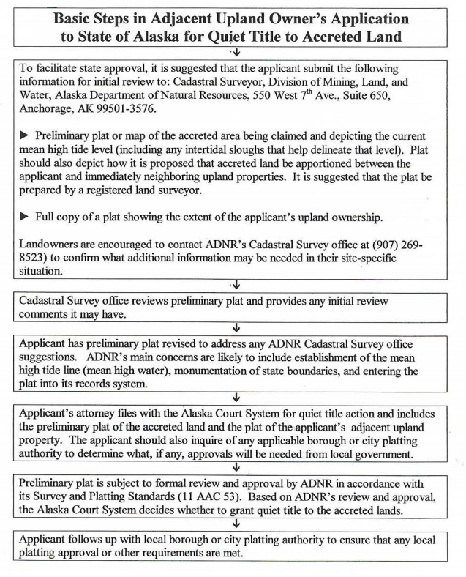
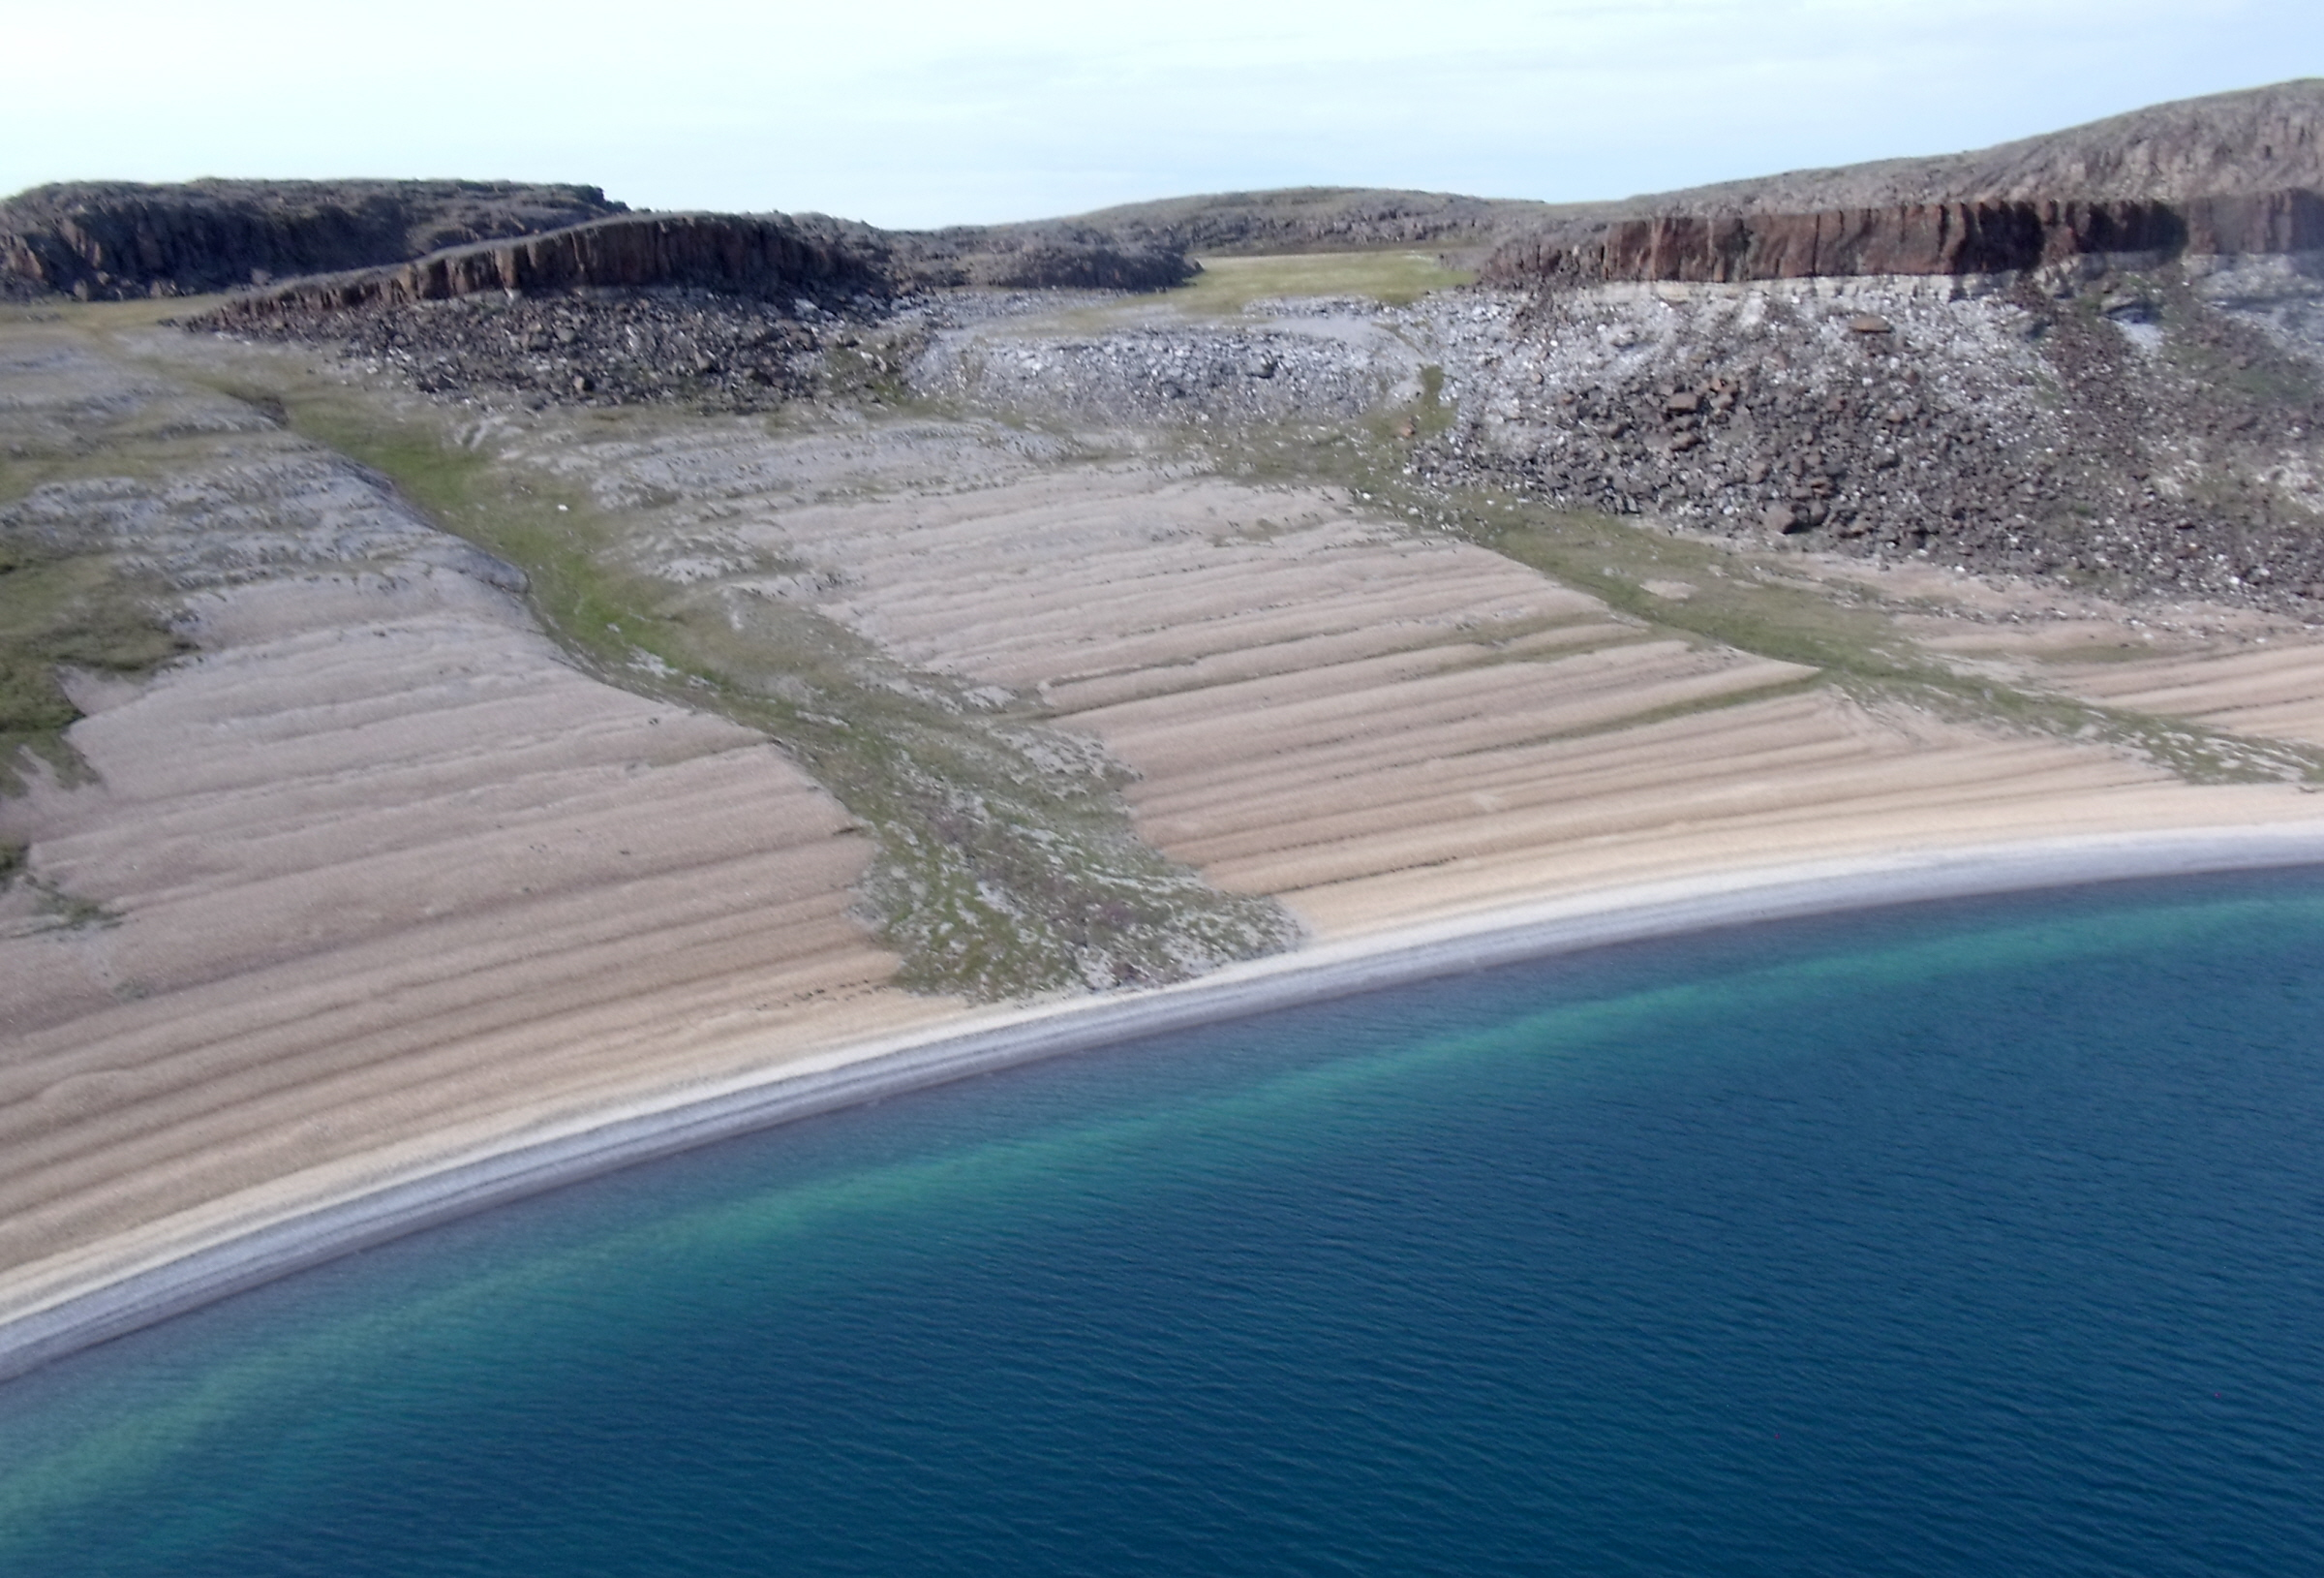

Slide 17
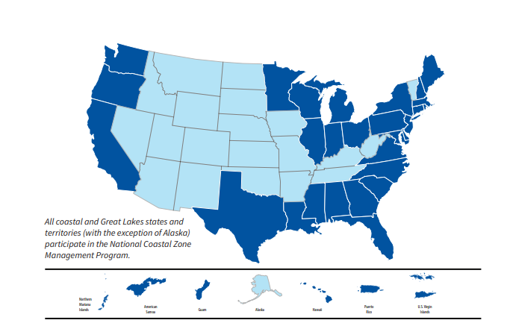
Coastal Zone Management act
Act formed in 1972. Overseen by NOAA Office of Coastal Resource Management
The goal is to “preserve, protect, develop, and where possible, to restore or enhance the resources of the nation’s coastal zone.”
Balancing act between Environment, Recreation, Energy Infrastructure, Ports of Commerce, Transportation, Navigation.
Voluntary Partnership between Coastal States and Federal Government, Allows states to manage own resources in individual and unique ways.
All 35 coastal states (Except Alaska….) Participate in this voluntary program

Slide 18
COASTAL ZONE MANAGEMENT PROGRAM REGULATIONS
CFR Title 15 → Subtitle B → Chapter IX → Subchapter B → Part 923
The primary components of the national program include the following:
The federal consistency component ensures that federal actions with reasonably foreseeable effects on coastal uses and resources must be consistent with the enforceable policies of a state’s approved coastal management program. This also applies to federally authorized and funded nonfederal actions.
The Coastal Zone Enhancement Program provides incentives to states to enhance their state programs within nine key areas: wetlands, coastal hazards, public access, marine debris, cumulative and secondary impacts, special area management planning, ocean and Great Lakes resources, energy and government facility siting, and aquaculture.
The Coastal Nonpoint Pollution Control Program ensures that participating states have the necessary tools to prevent and control polluted runoff.

Slide 19
Purpose and Scope
(c) In summary, the requirements for program approval are that a State develop a management program that:
(1) Identifies and evaluates those coastal resources recognized in the Act as requiring management or protection by the State;
(2) Reexamines existing policies or develops new policies to manage these resources. These policies must be specific, comprehensive, and enforceable;
(3) Determines specific use and special geographic areas that are to be subject to the management program, based on the nature of identified coastal concerns;

Slide 20
Purpose and Scope
(4) Identifies the inland and seaward areas subject to the management program;
(5) Provides for the consideration of the national interest in the planning for and siting of facilities that meet more than local requirements;
(6) Includes sufficient legal authorities and organizational arrangements to implement the program and to ensure conformance to it. In arriving at these elements of the management program, States are obliged to follow an open process which involves providing information to and considering the interests of the general public, special interest groups, local governments, and regional, State, interstate, and Federal agencies;
(7) Provides for public participation in permitting processes, consistency determinations, and other similar decisions;
(8) Provides a mechanism to ensure that all state agencies will adhere to the program; and
(9) Contains enforceable policies and mechanisms to implement the applicable requirements of the Coastal Nonpoint Pollution Control Program of the state required by section 6217 of the Coastal Zone Act Reauthorization Amendments of 1990.

Slide 21
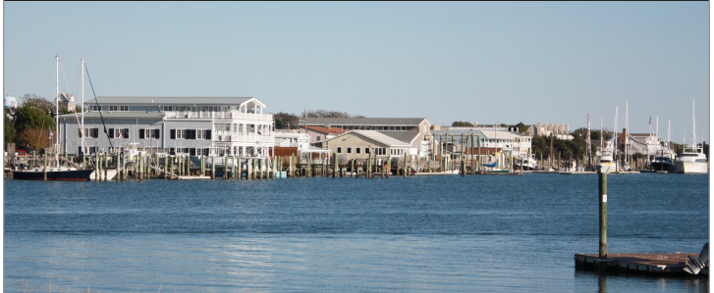
Federal Funding
Allocate Federal Matching Grants to States for Coastal Regions
  Program management
  Protecting and Restoring Coastal Habitats
  Planning for Ocean and Coastal Waters (Sustainable Fisheries)
  Mitigating Coastal Hazards
  Expanding Public Engagement
  Protecting Water Quality
  Enhancing Public Access
  Promoting Coastal Community Development

Slide 22
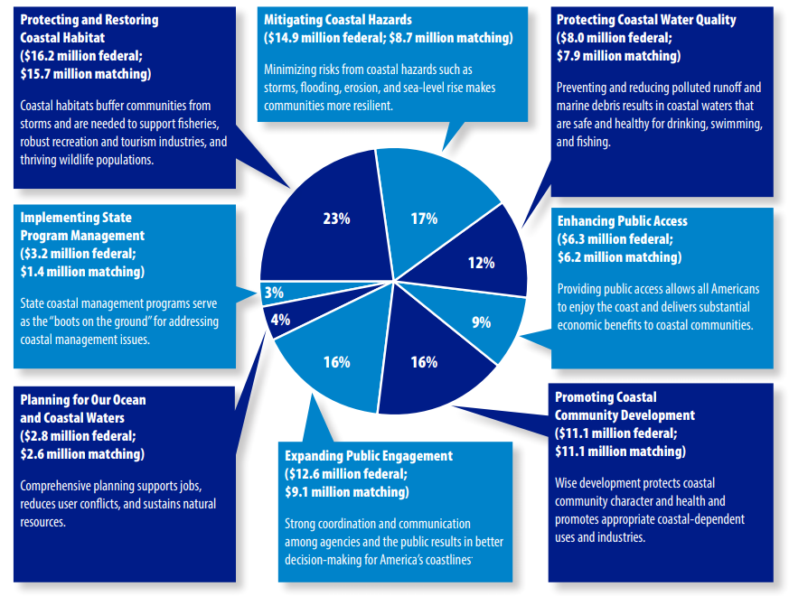

Slide 23
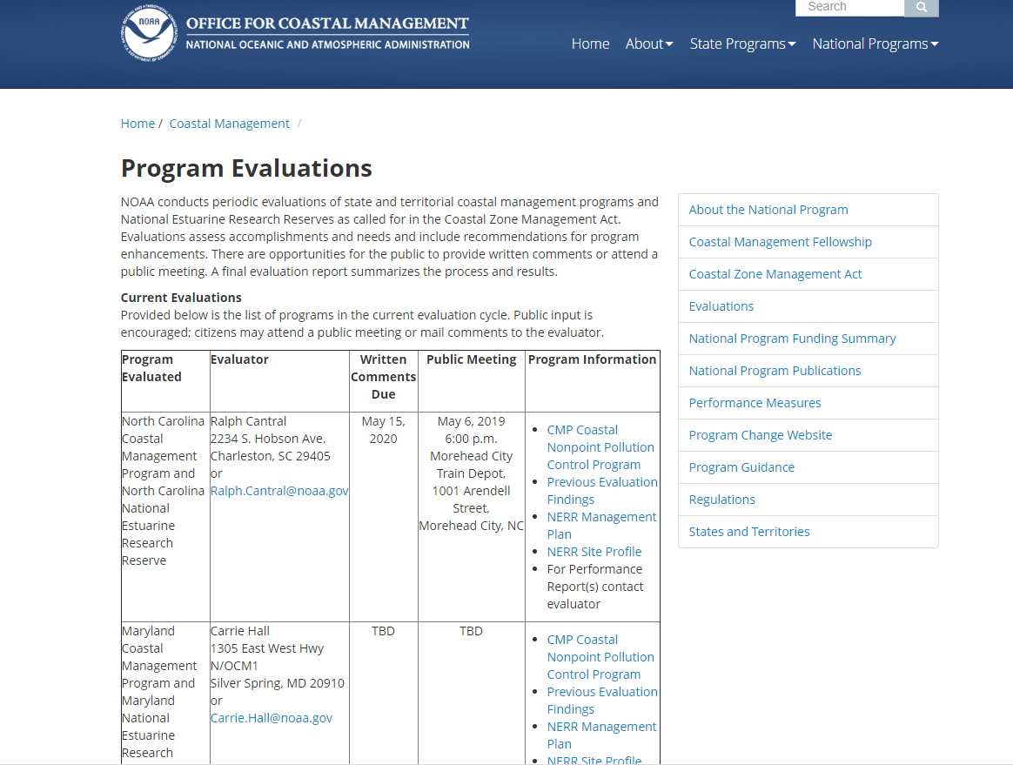
https://coast.noaa.gov/czm/evaluations/

Slide 24
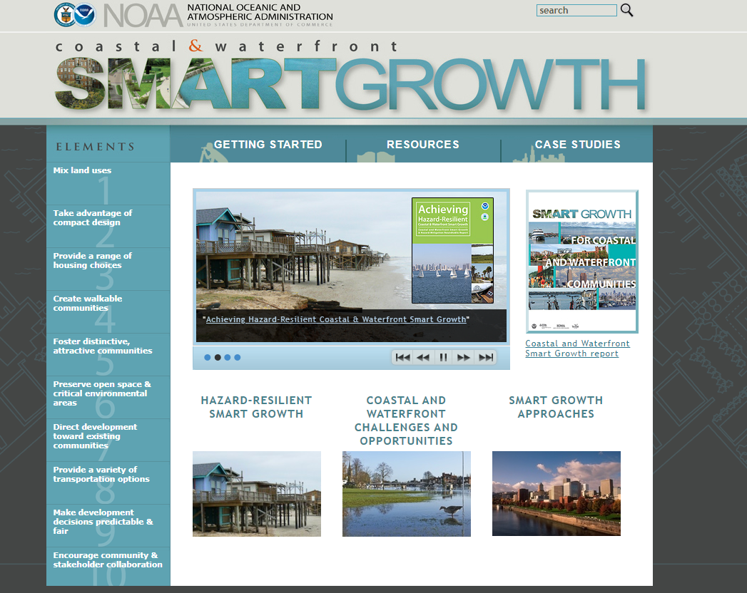
Resources for Communities

Slide 25
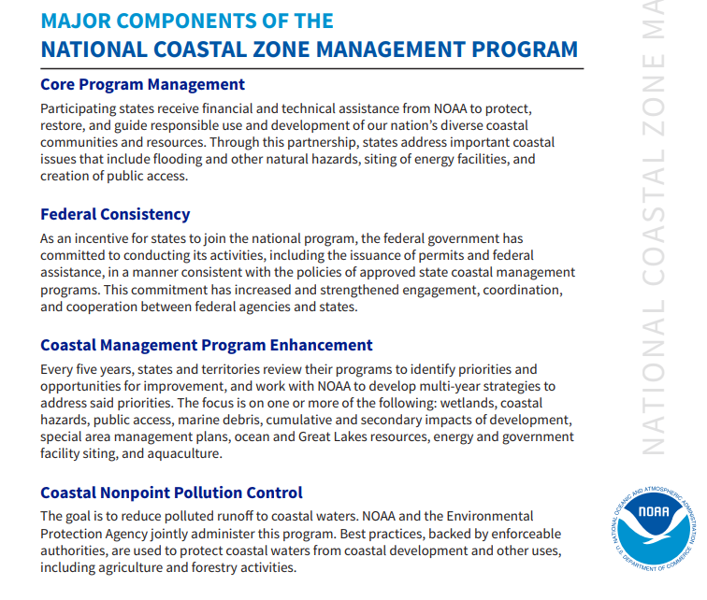

Slide 26
Sources:
http://dnr.alaska.gov/mlw/aquatic/pdf/ApplicationProcess.pdf
http://dnr.alaska.gov/mlw/factsht/land_fs/aquafarm.pdf
http://dnr.alaska.gov/mlw/factsht/land_fs/gen_allow_use.pdf
http://dnr.alaska.gov/mlw/factsht/land_fs/shorefish_fs.pdf
http://dnr.alaska.gov/mlw/planning/mgtplans/nushagak_mulchatna/pdf/Appendix_A.pdf
http://dnr.alaska.gov/mlw/permit_lease/
http://dnr.alaska.gov/mlw/aquatic/pdf/ProgramFlowChart_Legal-2.pdf
http://dnr.alaska.gov/mlw/aquatic/pdf/ApplicationProcess.pdf
http://dnr.alaska.gov/mlw/aquatic/pdf/Aquatic-Farming-Application-Form-and-Instructions.pdf
https://www.wslca.org/uploads/1/2/0/9/120909261/submerged_alaska_dnr_submerged_lands_management_july_2018.pdf
https://coast.noaa.gov/data/czm/media/czm-fact-sheet.pdf
https://coastalsmartgrowth.noaa.gov/
https://coast.noaa.gov/czm/act/

